Slide 1
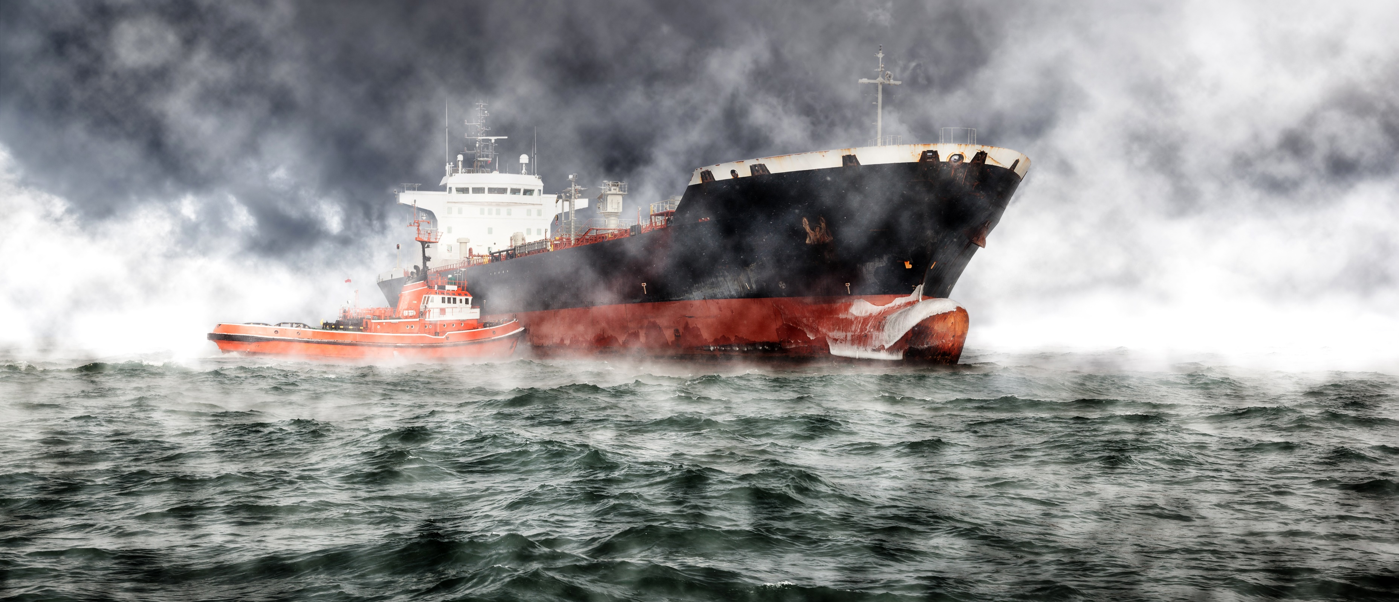
Noah’s Ark

Slide 2
New elevation data triple estimates of global vulnerability to sea-level rise and coastal flooding

Slide 3
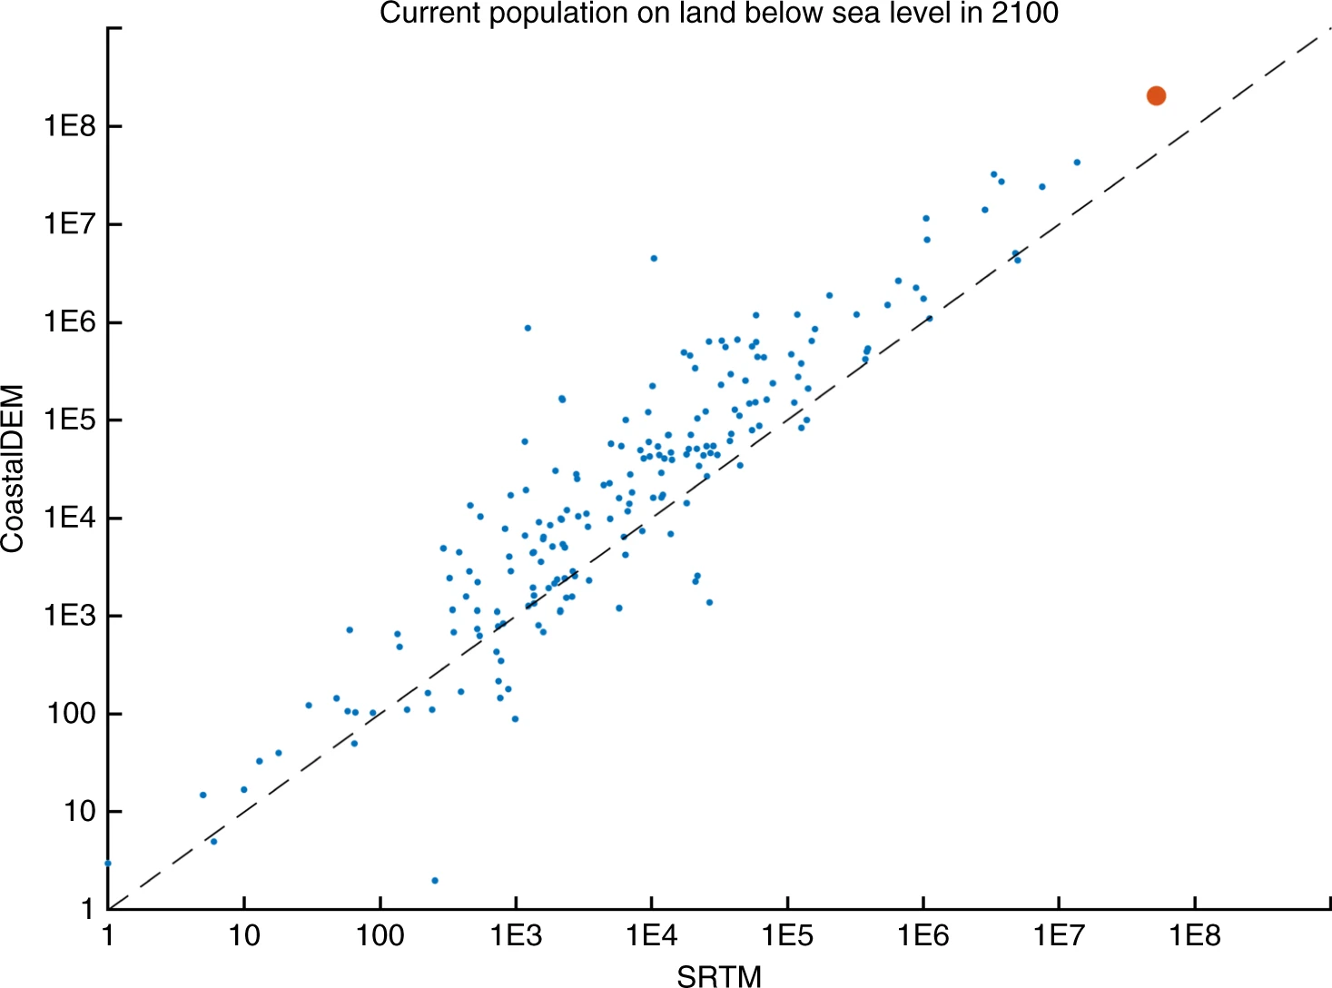

Slide 4
Sea Level Rise

Slide 5
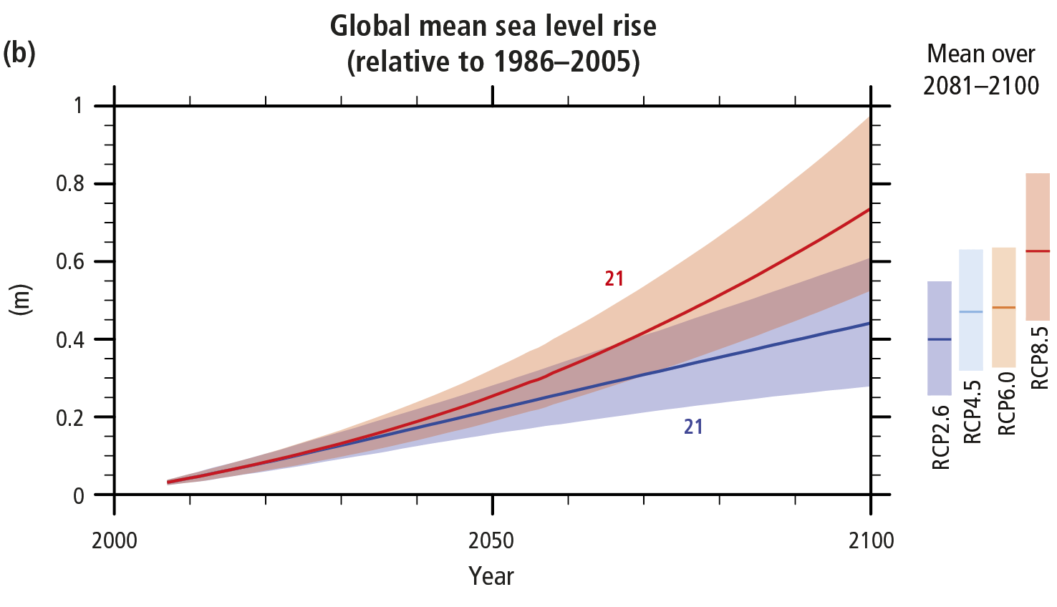

Slide 6
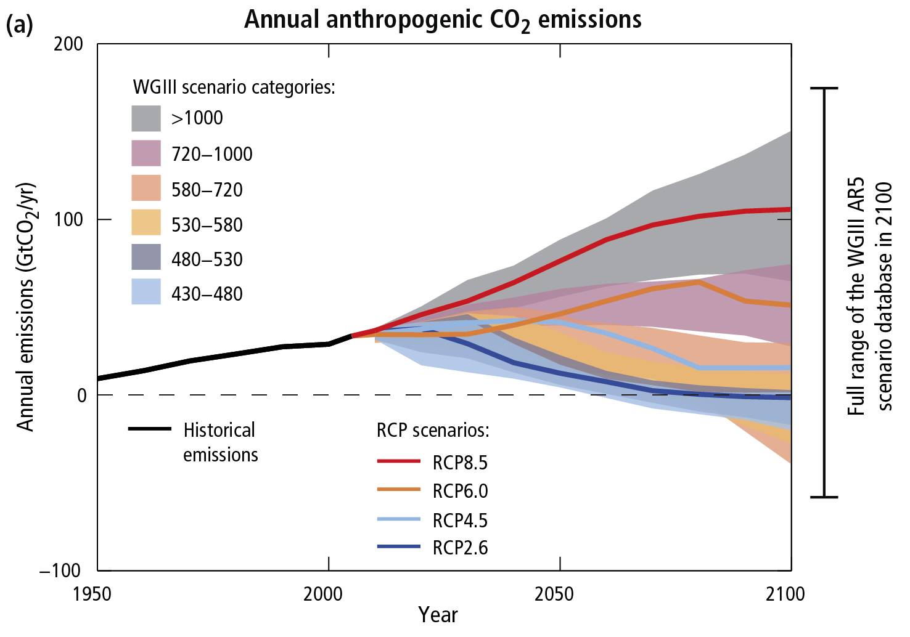

Slide 7
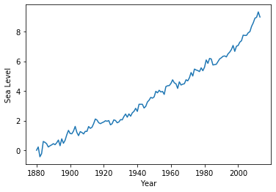
Global Average Absolute Sea Level Change, 1880-2014

Slide 8
Cities
Geography & Population

Slide 9
Data
Simple Maps
Latitude, altitude, population
bahar on GitHub
Elevation
Data from Aneki World Cities

Slide 11
Noah’s Ark

Slide 12
References
IPCC, 2014: Climate Change 2014: Synthesis Report. Contribution of Working Groups I, II and III to the Fifth Assessment Report of the Intergovernmental Panel on Climate Change [Core Writing Team, R.K. Pachauri and L.A. Meyer (eds.)]. IPCC, Geneva, Switzerland.
Kulp, S.A., Strauss, B.H. New elevation data triple estimates of global vulnerability to sea-level rise and coastal flooding. Nat Commun 10, 4844 (2019) doi:10.1038/s41467-019-12808-z

Slide 13
Data Hub: Global Average Absolute Sea Level Change, 1880-2014. https://datahub.io/core/sea-level-rise.
Simple Maps: World Cities Database. https://simplemaps.com/data/world-cities.
bahar: World City Locations Database. https://github.com/bahar/WorldCityLocations.
JawgMaps: Elevation API. https://www.jawg.io/docs/apidocs/elevation/.

